Slide 1

Imam Abdulrahman Bin Faisal University
Web Business Applications | BIS 351
ChefLak
PROFESSIONAL CHEF BOOKING PLATFORM
Hussain Al Ali
Sultan Al-Khalaf
Ahmed Al Qasum
Faris Al-Dahsh
2240000936
2240003003
2240005481
2240004926
Academic Year 2025–26 | Final Project Report

Slide 2



Executive Summary
Project Overview
Technical & Strategic Focus
ChefLak is a business-focused web app for BIS 351 at Imam Abdulrahman Bin Faisal University, connecting freelance chefs with clients for custom home dining across the Eastern Province.
Built as a Single Page Application using native HTML5, CSS3, and JavaScript, covering authentication, discovery, booking, payment simulation, and order management.
The Market Gap
Vision 2030 Alignment
Addresses the lack of a centralized, trusted digital solution for private chef booking in the region.
Supports Saudi Arabia's digital transformation goals and demonstrates mastery of CLO S-1 standards.

Slide 3



Value Proposition
Industry Challenges
The ChefLak Edge
Fragmented Market
Centralized Discovery
Private chef services are currently scattered across social media (Instagram/WhatsApp), making discovery difficult and time-consuming.
A unified digital storefront showcasing diverse culinary specialties, ratings, and portfolios in one place.
Lack of Transparency
Real-time Booking
Pricing and availability are often hidden, requiring multiple inquiries and manual negotiations for every event.
Automated booking flow with live cost calculation based on duration, eliminating manual back-and-forth.
Inconsistent Quality
Verified Trust
No standardized rating or verification system exists to ensure the quality and safety of freelance culinary services.
Transparent rating system and standardized service fees ensure professional accountability for both chefs and clients.

Slide 4




Market Analysis: SWOT
Strengths
Weaknesses
Bilingual SPA architecture (Arabic/English)
Limited initial geographic coverage (Eastern Province)
Transparent live cost calculation system
New brand entering a competitive F&B market
Verified rating and review ecosystem
Dependency on freelance chef availability
Opportunities
Threats
Alignment with Saudi Vision 2030 digital goals
Established food delivery giants entering the niche
Expansion to major cities like Riyadh and Jeddah
Fluctuating regulatory requirements for home catering
Growing demand for personalized gig-economy services
Economic shifts affecting luxury dining spending
PESTLE INSIGHTS
Political: Vision 2030 support.
Economic: Rising gig economy.
Social: Demand for home privacy.
Technological: SPA & i18n innovation.
Legal: PDPL & SFDA compliance.

Slide 5



Technical Implementation
Native Tech Stack
SPA Architecture
Core Business Logic
HTML5 & CSS3: Semantic structure with Glassmorphism styling.
DOM Manipulation: Dynamic updates without full reloads.
i18n Engine: Bilingual engine supporting RTL Arabic & LTR English.
Vanilla JavaScript: Zero-dependency implementation for fast loads.
State Management: Global JS objects for persistence.
Live Calculation: Real-time cost engine for bookings.
Responsive Design: Fluid breakpoints for desktop & mobile.
Performance: Optimized assets and event handling.
Validation: Client-side regex for Saudi numbers & card data.

Slide 6

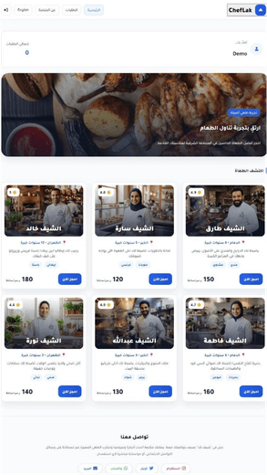
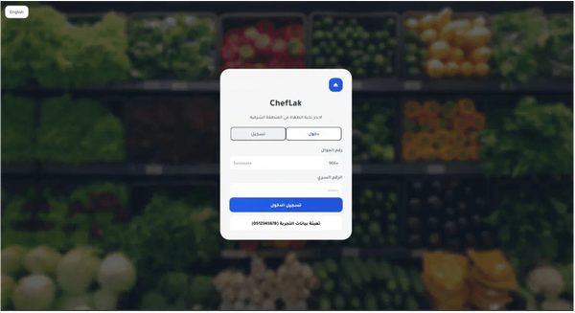
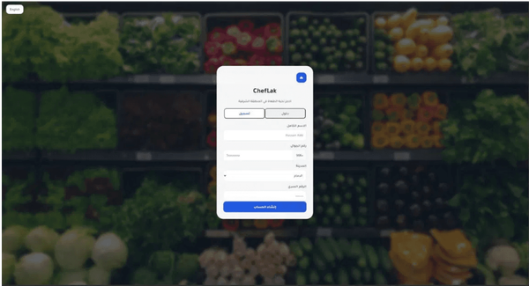
User Interface: Onboarding & Discovery
STEP 01
STEP 02
STEP 03
Secure Login
User Registration
Chef Discovery

Slide 7
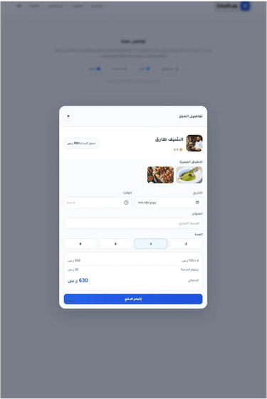
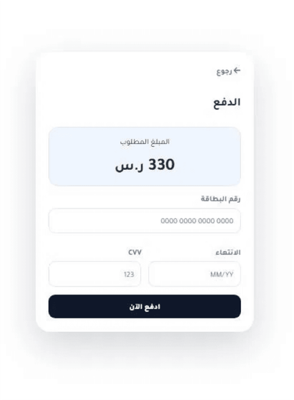
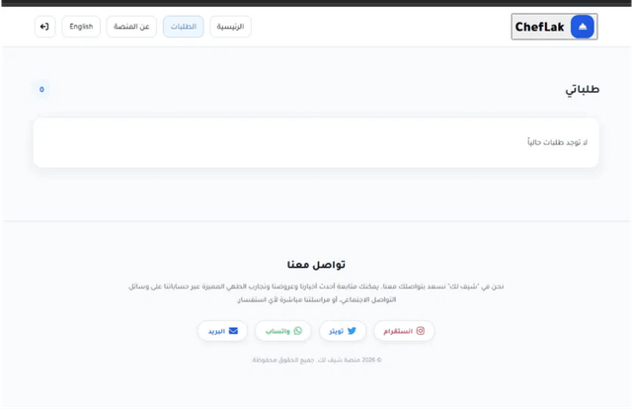
User Interface: Booking & Payment Flow
STEP 04
STEP 05
STEP 06
Empty State UX
Booking Engine
Secure Checkout

Slide 8
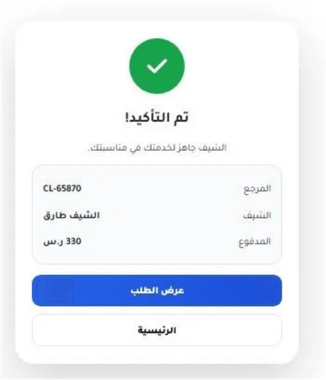
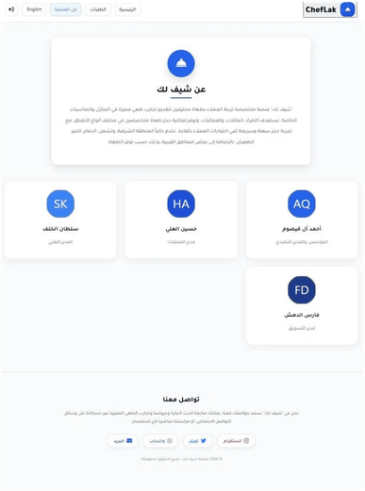
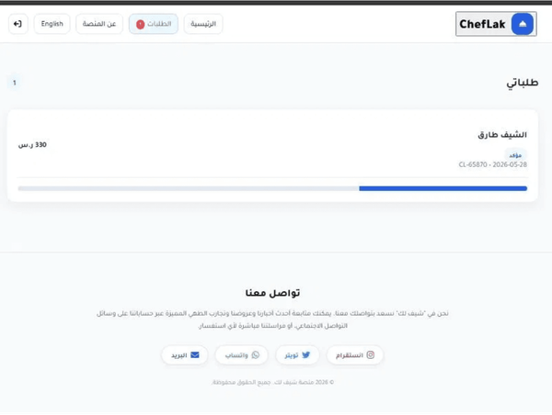
User Interface: Fulfillment & Team
STEP 07
STEP 08
STEP 09
Order Confirmation
Order Management
Mission & Team

Slide 9


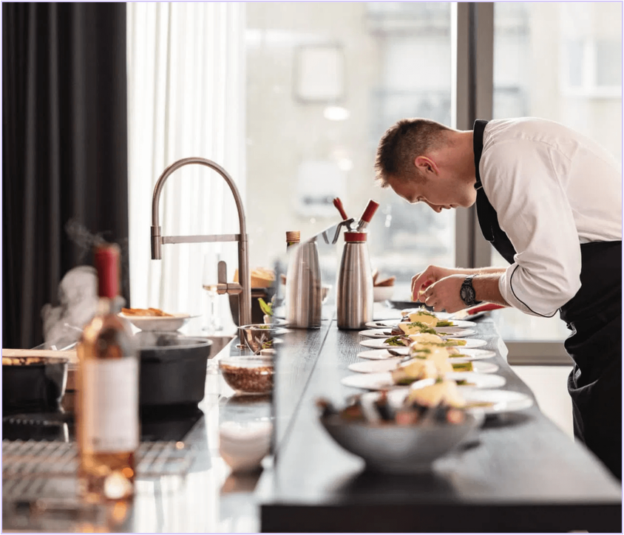


Values, Ethics & Legal Responsibility
Data Privacy & PDPL Compliance
ChefLak follows Saudi PDPL. Passwords are bcrypt-hashed and payments use tokenized providers, so no raw card data is stored.
Fair Treatment of Gig Workers
Chefs set their own rates and all service fees are shown to clients upfront, ensuring transparency and fairness.
Food Safety & Consumer Protection
Onboarded chefs provide municipal health certificates and SFDA compliance where required; ratings add continuous accountability.

Slide 10




Conclusion & Future Roadmap
Geographic Expansion
Scaling operations beyond the Eastern Province to establish a presence in Riyadh and Jeddah, targeting high-demand urban centers across the Kingdom.
Service Diversification
Introducing subscription-based models for recurring family dining and premium "Chef Masterclasses" for interactive culinary education.
Mobile Ecosystem
Transitioning from a web-based SPA to native iOS and Android applications, featuring real-time push notifications and AI-driven menu personalization.

